Slide 1
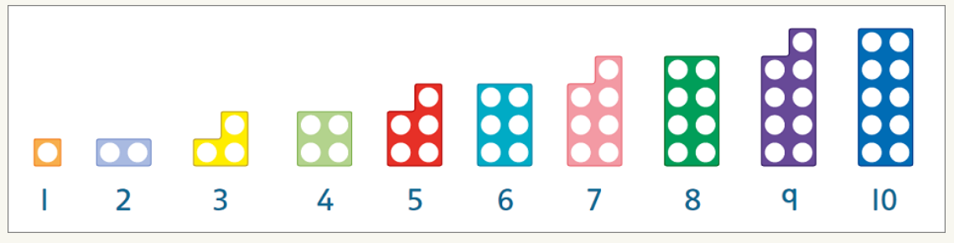
Numicon at home

Slide 2
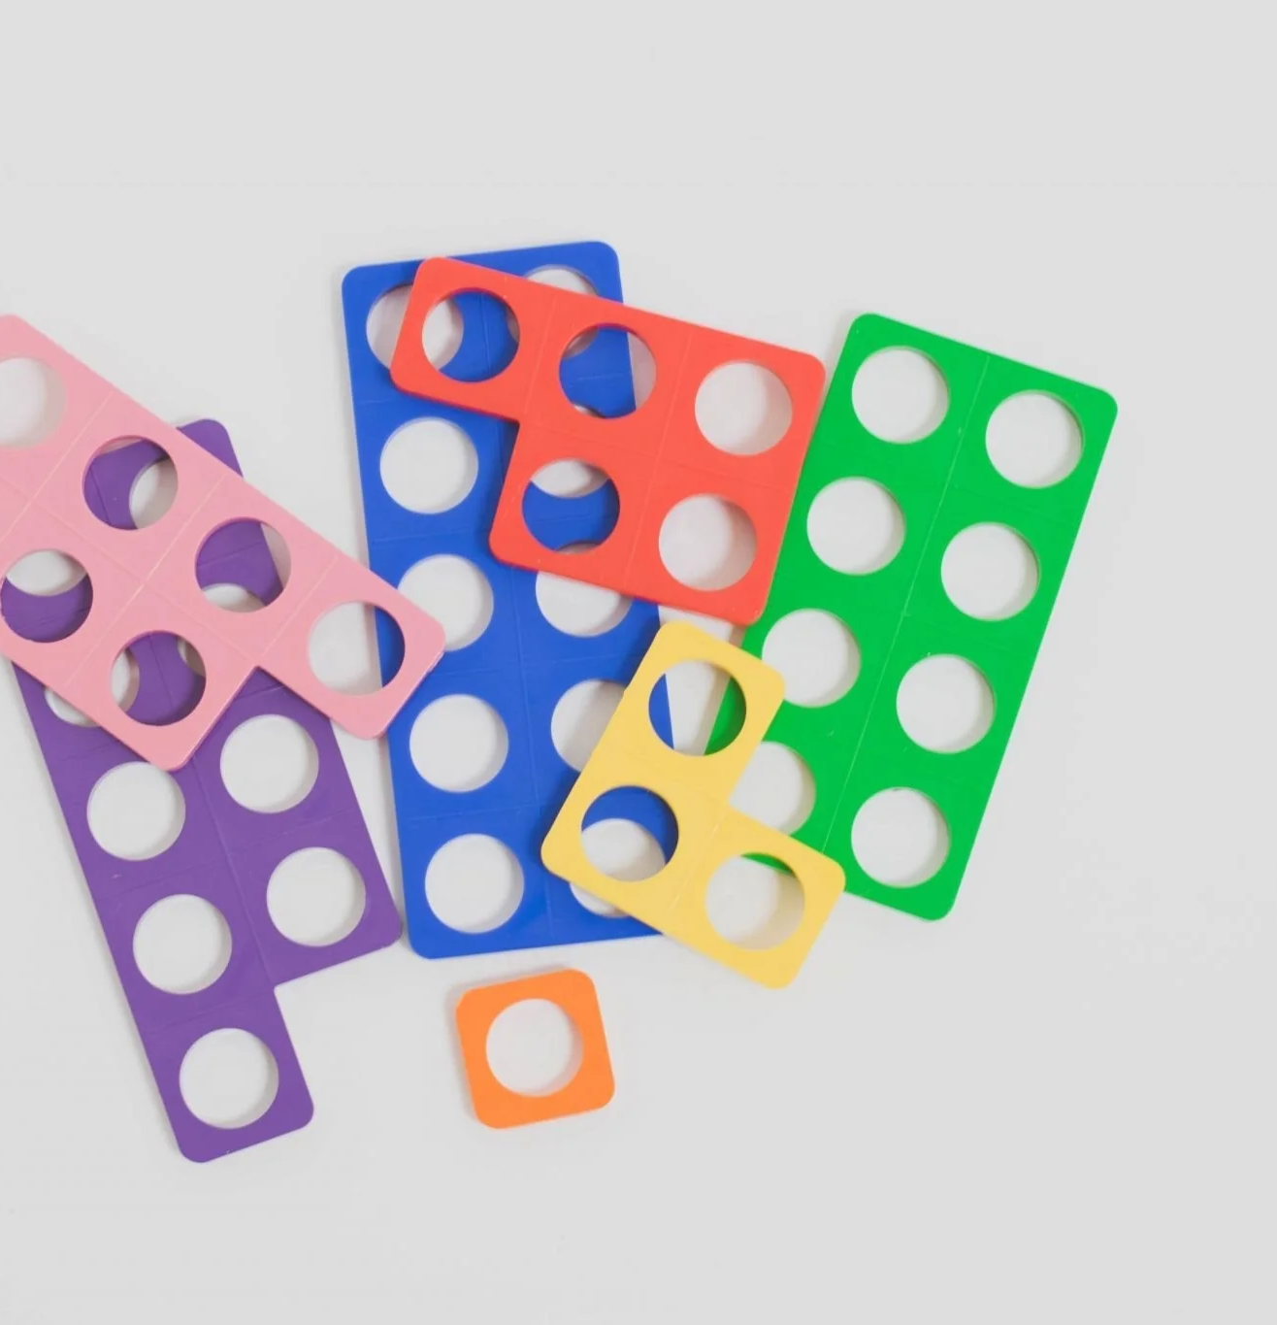
What is Numicon?
Oxford University Press has a wealth of information on Numicon that you can access through their website:
Numicon guide for parents - Oxford Owl for Home
Numicon is an approach to teaching maths that helps your child to see connections between numbers. From Oxford University Press, it supports your child as they learn early maths skills in nursery and primary school. It is a multi-sensory way of learning, which means your child learns by seeing and feeling.

Slide 3
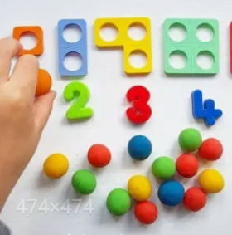
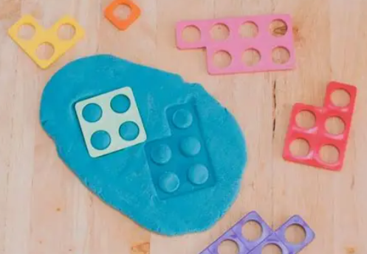
Numicon and Playdough
What shapes can you make?
Can you make the correct amount of playdough balls to match the Numicon?

Slide 4

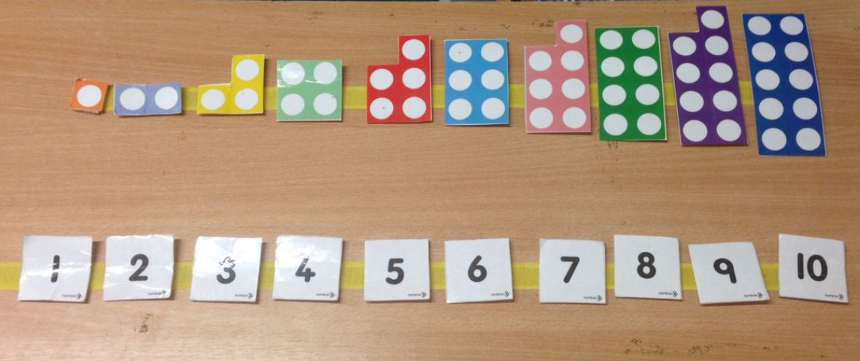
Numicon Games
Hide the Numicon shapes for your child to find in order
Match the Numicon shapes to the numeral
Take one away, can your child say what Numicon or numeral that is missing

Slide 5
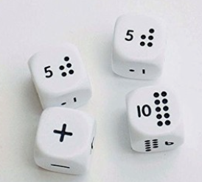
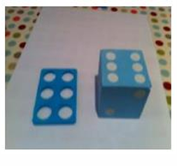
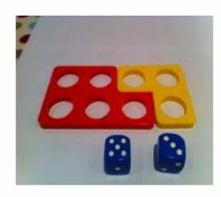
Numicon and Dice
Match the number thrown to the Numicon piece
Throw two and find both shapes
  What is the total
  Which shape has more/fewer holes

Slide 6
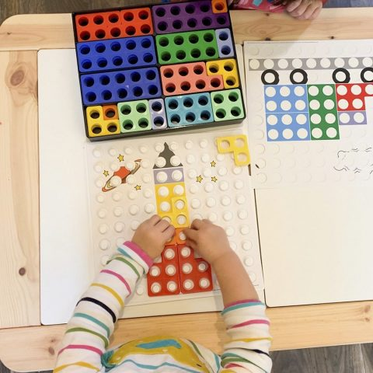
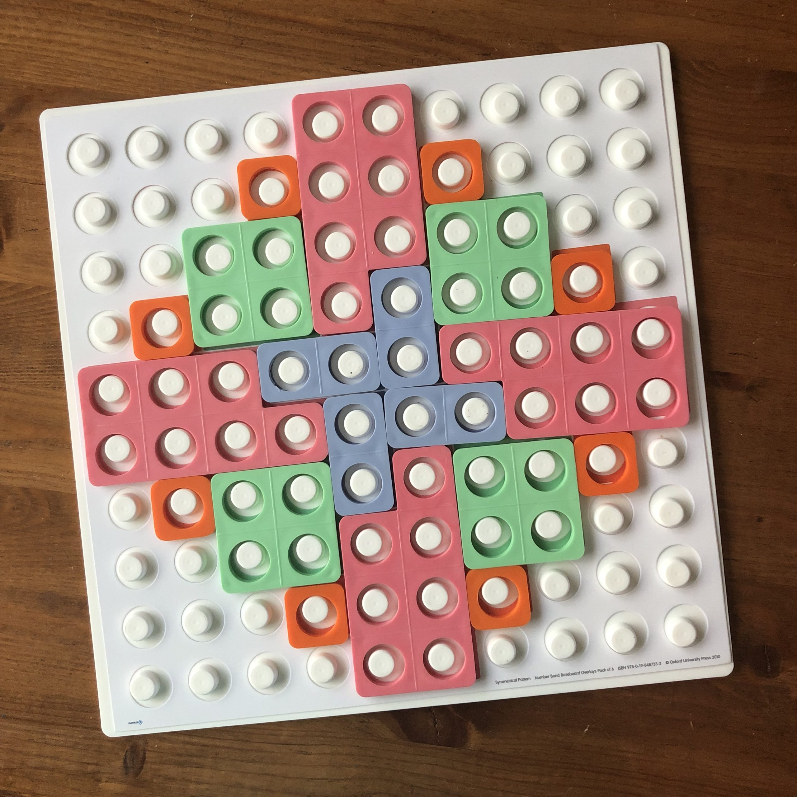
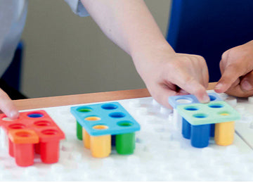
Numicon Baseboards
Fill the baseboard
  Take one shape away and then challenge your child to fill the gap with two different shapes
Complete or make a picture using the shapes
Roll a dice and add that shape to the board

Slide 7
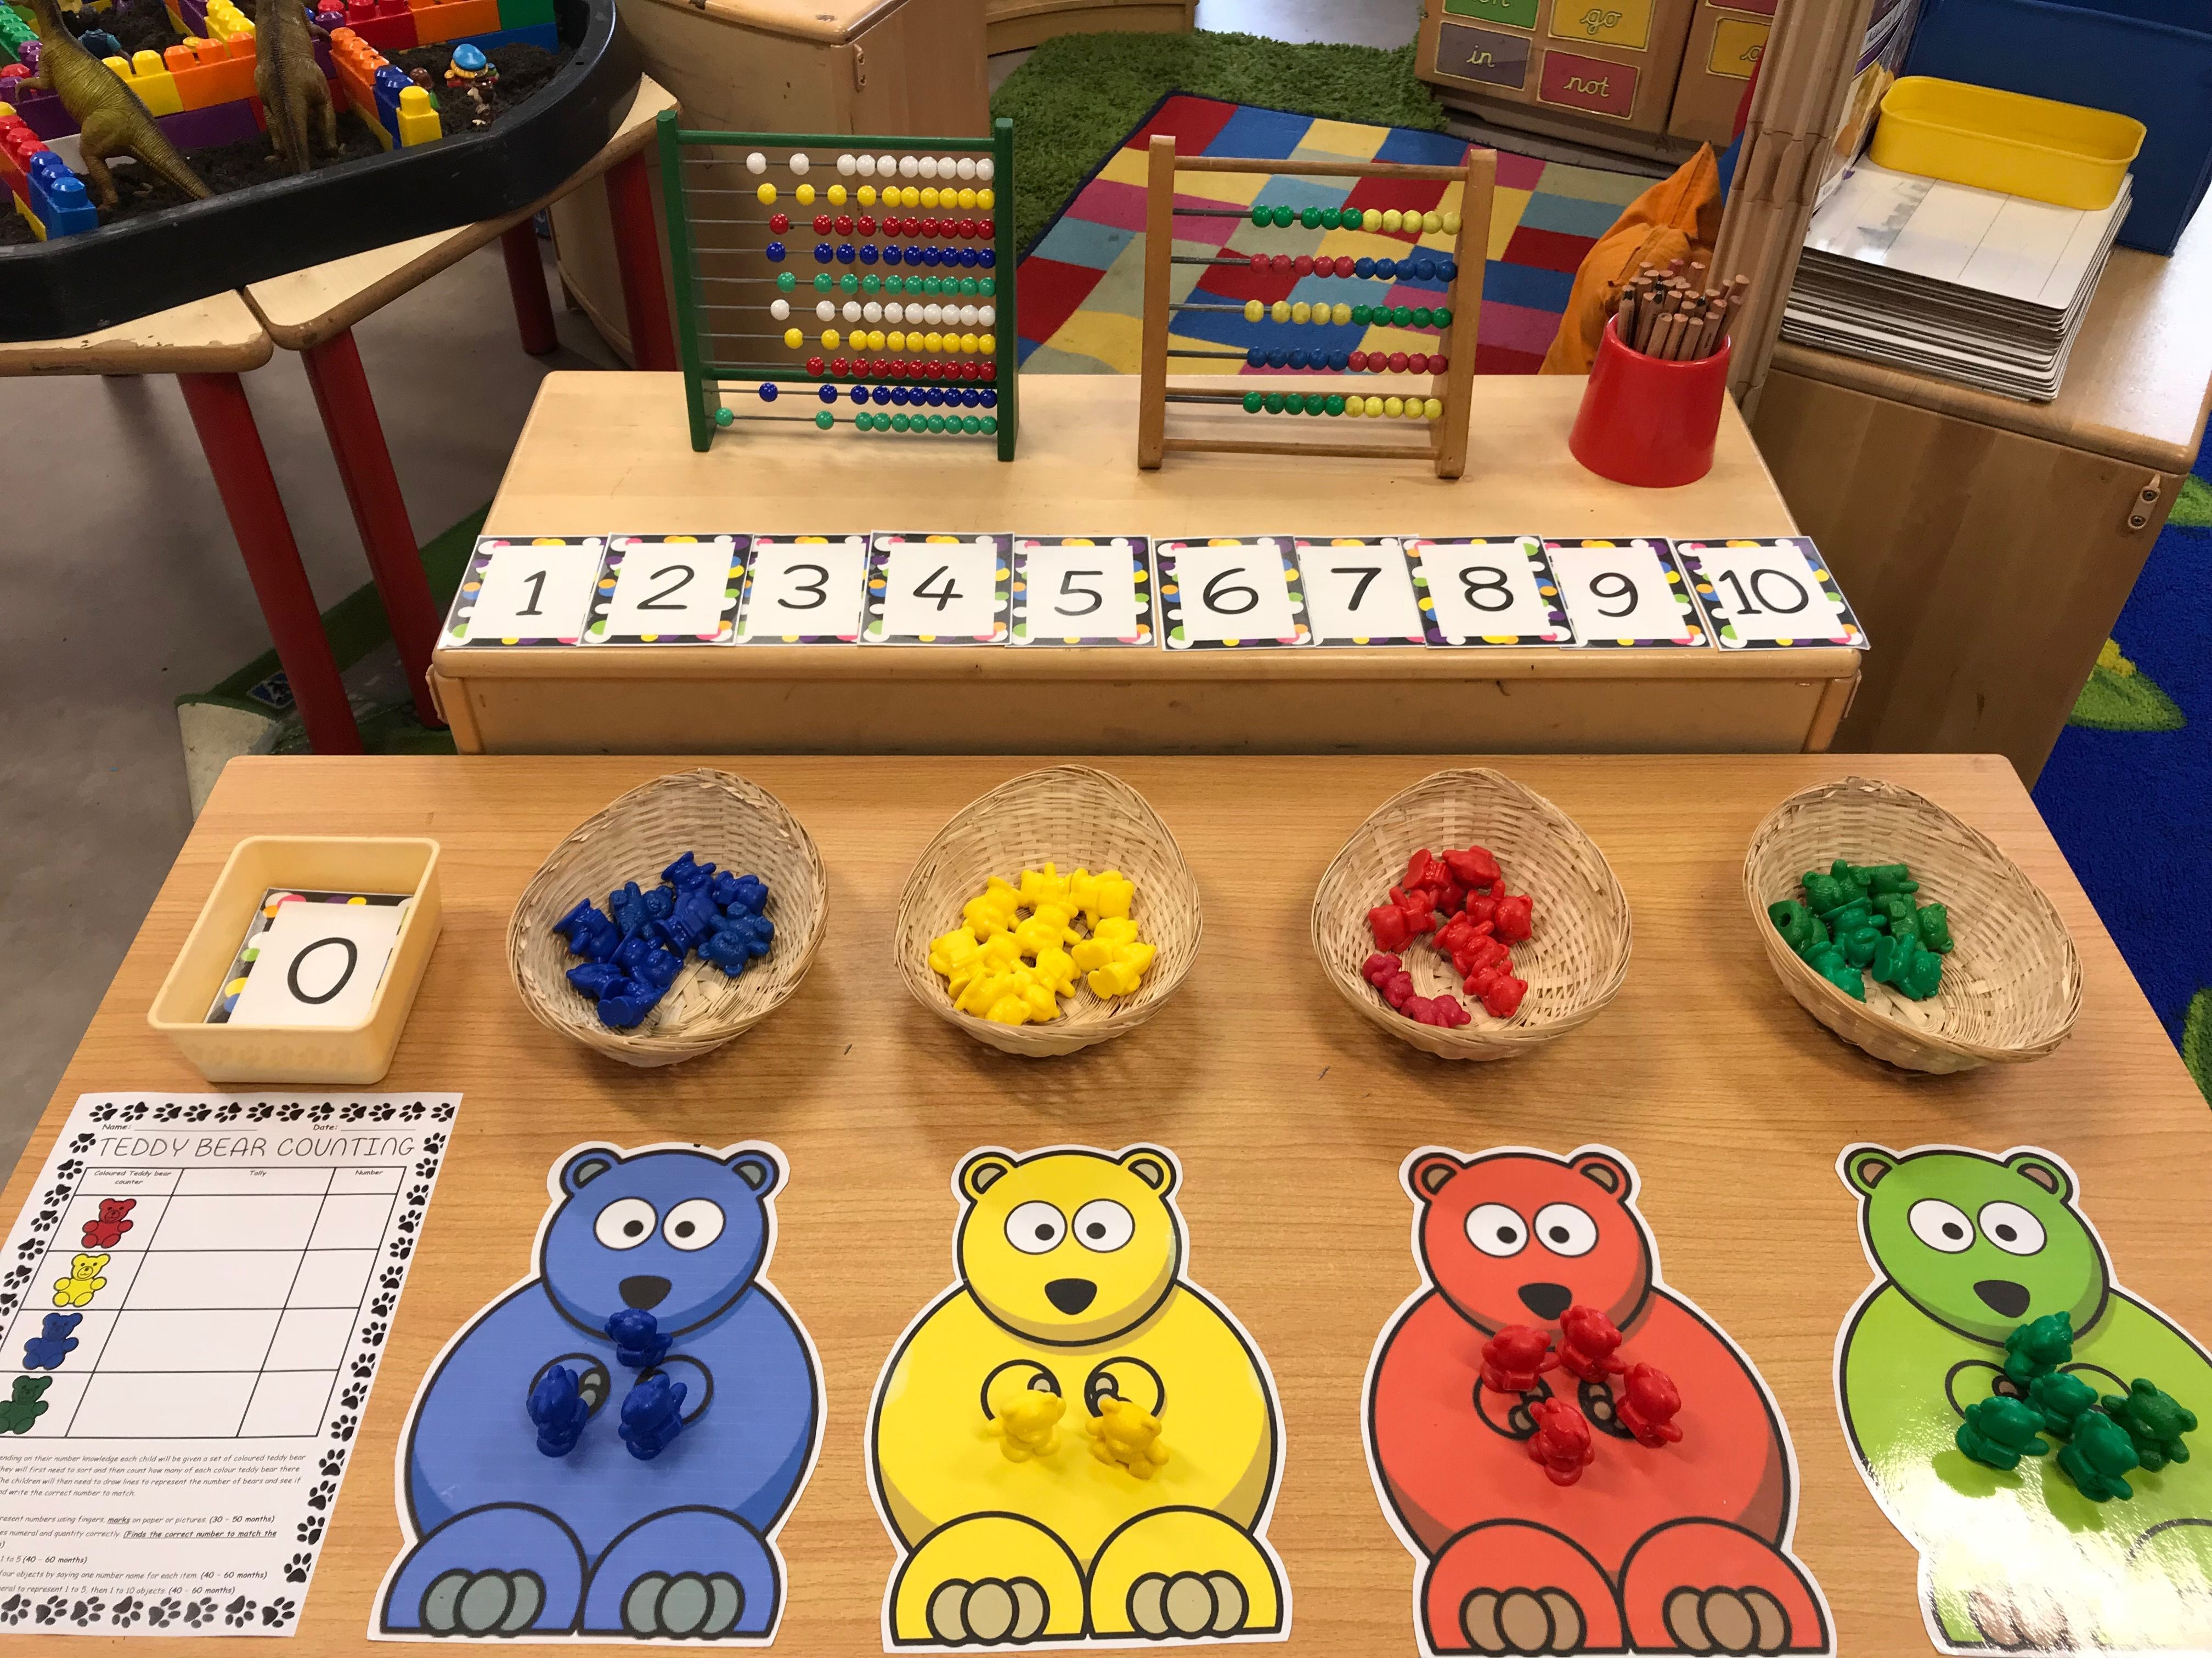
More Maths Support
The websites below have further support for Maths at home:
https://www.nationalnumeracy.org.uk/helping-children-maths/family-maths-toolkit
https://www.surreycc.gov.uk/__data/assets/pdf_file/0007/67354/count-with-me-leaflet-4-years-plus.pdf
https://nrich.maths.org/parents/early-years

