Slide 1
Year 4 overnight science stay
Friday 12th June – Saturday 13th June

Slide 2
Overall intended learning outcomes:
Support science curriculum
team building
social skills
confidence building

Slide 3
OVERNIGHT STAYS 2025 – Aston Clinton school
Year 4 – one night
Year 5 – two nights (School field – Big Camp Out)
Year 6 – four nights

Slide 4
Friday 12th JuNE provisional TT
8:30 – 8:45: Arrive at ACS at the normal time
Children will arrive at school wearing their own clothes and 2 bags (day and night).
9:30: Depart ACS
Coach will depart from ACS and head towards Hertfordshire Zoo.
10:30 am – 3:30pm Zoo Exploring the zoo and science workshops
3:30pm: depart zoo arriving back to ACS about 4.30 pm.
4.30pm – 6pm: free time plus activities linked to visit
6 pm: pizza time
7pm- 8pm: activities and getting changed for bed.
8 pm: film with snacks……brush teeth and then (hopefully) sleep!

Slide 5
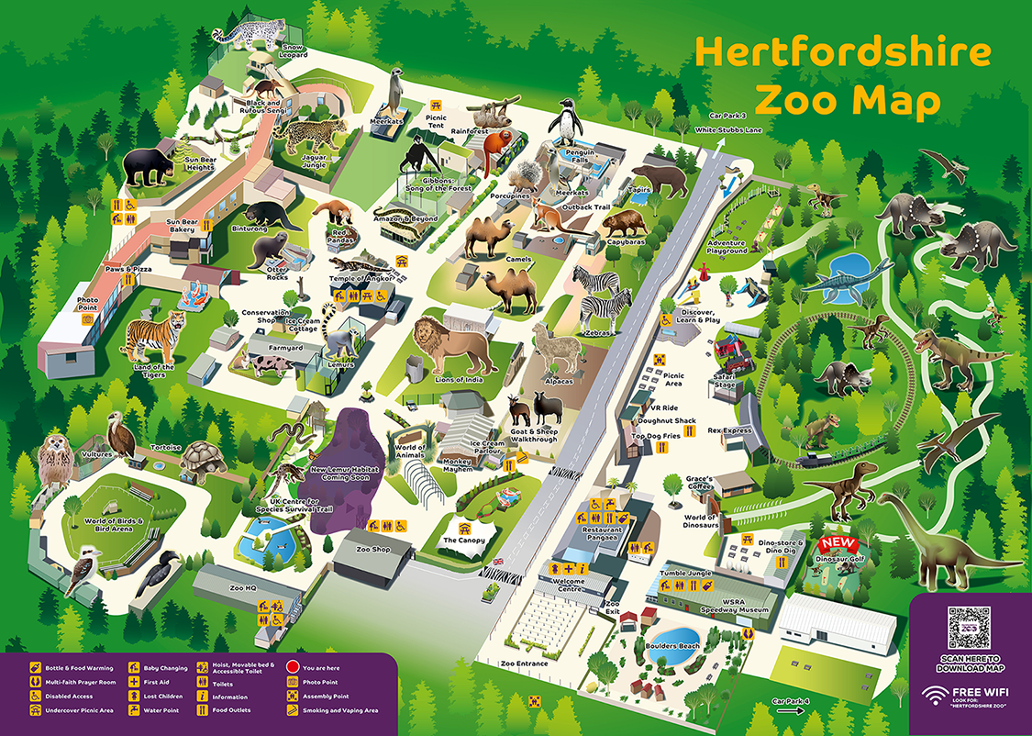

Slide 6
At the zoo
Classes will explore the zoo together 4OL and 4MW have workshops at different times during the day.
Packed lunch at about 12.30 pm together.
We will not be visiting the shop we will also not be using any of the extra paid for attractions such as the train.

Slide 7
Back at school:
Free time and activities before eating.
Food will be eaten in the year 4 classrooms.
More activities/games after eating
Children will get changed in the classrooms-boys in one class and girls in the other.

Slide 8
Food
The evening food is pizza from dominoes.
Morning-croissants, fruit and juice.
We usually order 2 or 3 different pizza options. Chicken and wedges for any child who really will not eat pizza. Or a home packed tea can be provided.
We will be sending out a survey to help us organise what to order.
We know the dietary needs of different children so will cater for them.
Please speak to us if you have further questions.

Slide 9
Overnight campout in the hall
In the hall children will sleep on PE mats laid out in rows-boys one side and girls on the other.
After watching film, children will brush teeth/use toilets and get into bed.
Children will have access to toilets along well lit corridor during night.
Teachers will stay up until all children settled and asleep.
Two teachers will sleep in the hall with children to be available if needed at any time.

Slide 10
Saturday 13th June
7:00am – Wake up (hopefully not before!)
Wake up/ brush teeth/ get dressed – use of the toilets and classrooms.
Pack away belongings and tidy hall.
7:45am – Breakfast
Children will be offered a variety of pastries (e.g. croissants), fruit and juice for breakfast.
8:30am – Pick up from ACS
All children to be collected from the KS1 playground at 8:30am.

Slide 11
YOUR CHILD Will NEED TO BRING:
For the zoo visit:
Children to wear own clothes suitable for a day outside.
They will also need a coat and a sun hat.
They will need to bring
A backpack containing:
A snack for midmorning
A packed lunch
A water bottle
sun cream-please can sun cream be applied at home before coming into school.

Slide 12
YOUR CHILD Will NEED TO BRING:
For the overnight stay:
Toothbrush + toothpaste
Small hand towel
Pyjamas
Flip flops or slippers or other footwear that can be worn once ready for bed for toilet visits etc.
One favourite cuddly toy
Sleeping bag and pillow, slim self inflating sleep mat if desired.
Snacks to eat during film (no nuts)
(Water bottle – can be refilled when we return to school)

Slide 13
WHAT happens next?
Make sure the consent forms are completed.
We must have contact details in case we need to phone home.
Please make sure you are contactable in case of an emergency.
Medicines need to be brought to school with a completed form via the office.
Please do not send your child to school with a mobile phone.

Slide 14
Thank you for listening!
If you have any questions or would like any further information, please speak to or contact your child's class teacher.

