Slide 1
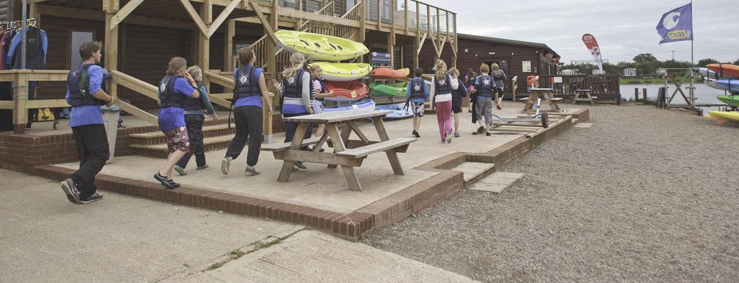
Year 6 Residential 2026
Croft Farm Water Park, Tewkesbury, Gloucestershire
Monday 13th – Friday 17th July 2026

Slide 2
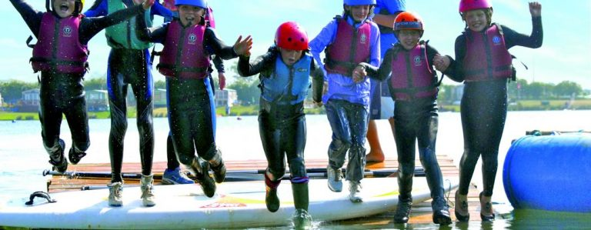
Why we chose this destination:
Heart of the Cotswolds / historic town of Tewkesbury
lovely setting / adjoining footpath meandering through to the River Avon
options for enjoying outdoor activities on both land and water
JCA –> 30+ years of experience of school trips
Approx. 2 hour journey
Staffing:
Mr Soley
Mrs Proudfoot
Mrs Giles
Mr Arnold
Miss McGill

Slide 3
Benefits of residentials:
beneficial effects of learning outside the classroom
new and exciting challenges
children learn to work together as a team
develop independence, confidence and an ability to recognise strengths and weaknesses in a constructive way

Slide 4
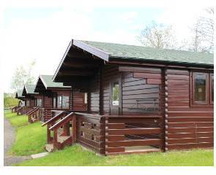
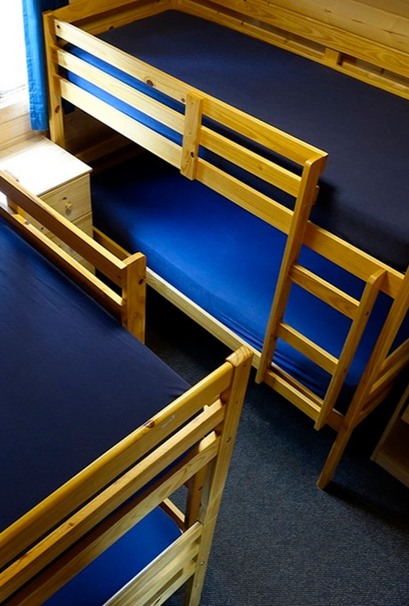
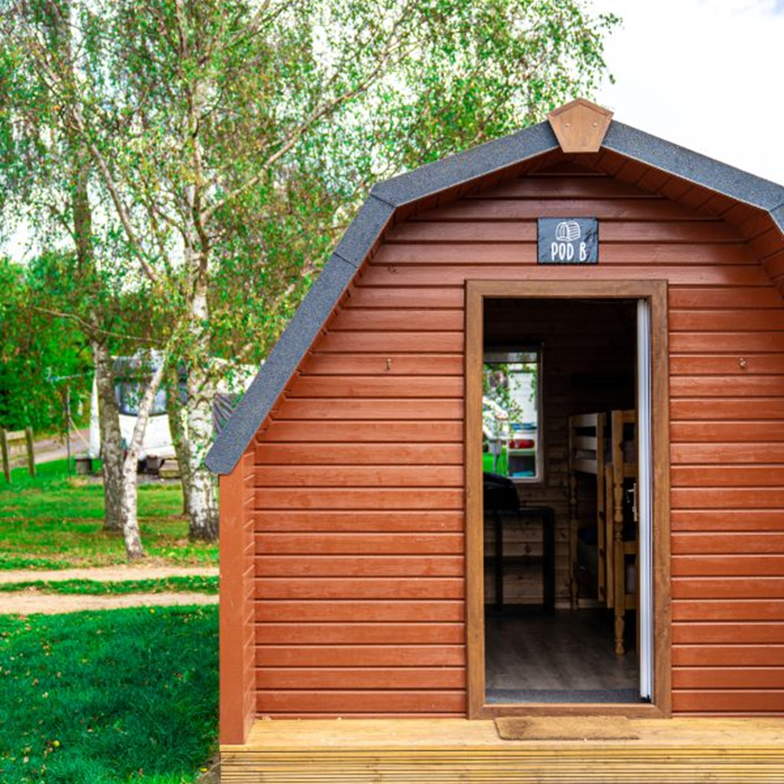
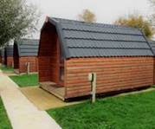
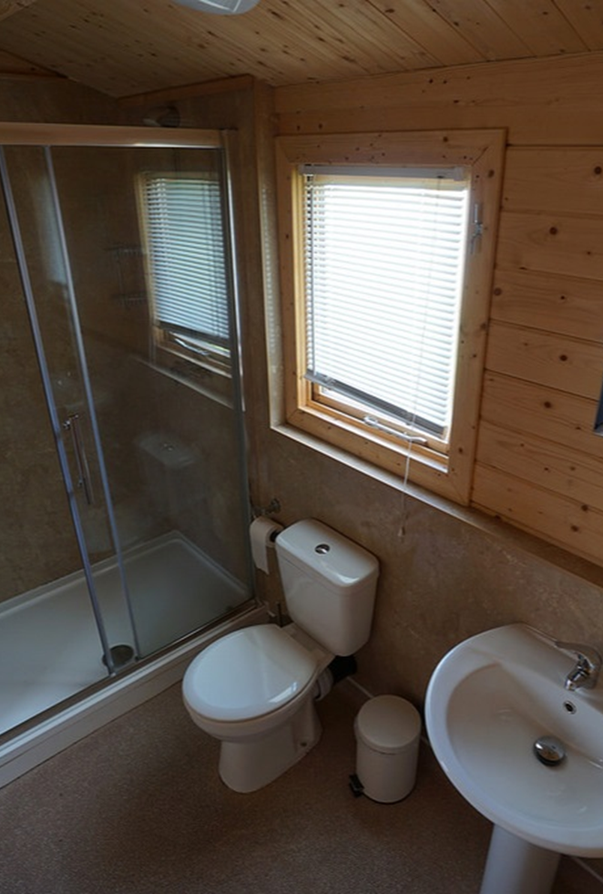
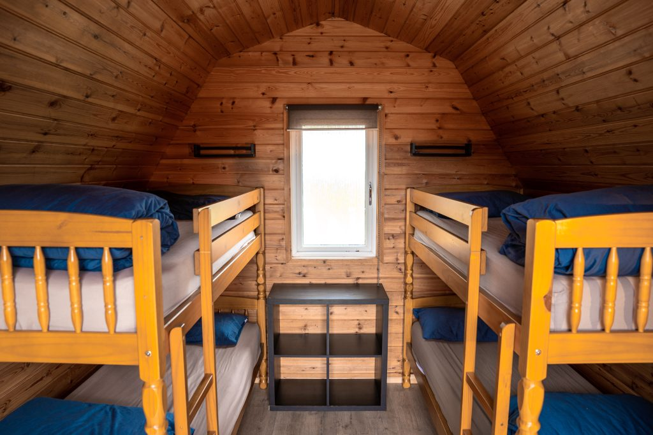
ACCOMMODATION
CABINS
PODS
Cabins – two separate bedrooms of up to 4 children and a small entrance area, ensuite
Pods – sleep 4, toilets nearby (we have sole use)

Slide 5
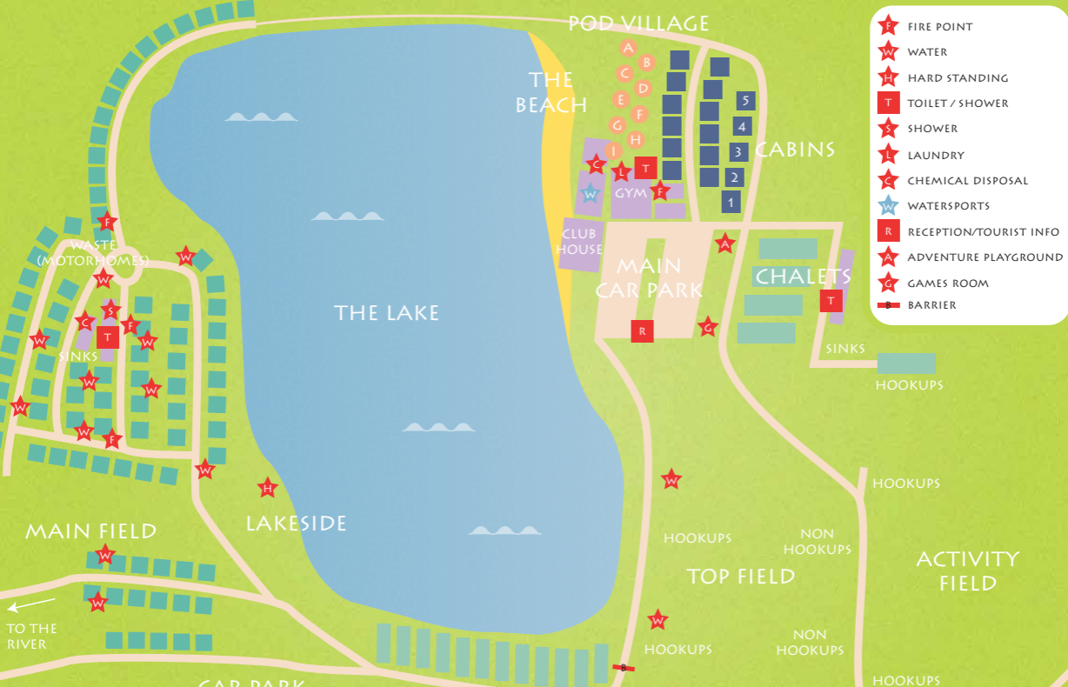
School activities in own fenced area / patrolled by JCA staff / Night Porter patrols over night

Slide 6
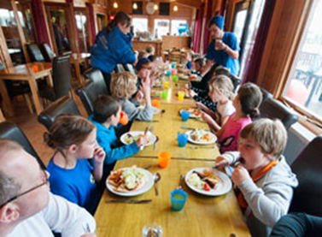
MEALS
Example:
Breakfast
Cereal –e.g. Cornflakes and Rice Crispies
Toast, butter and jam
Cooked breakfast (e.g. scrambled eggs, hash browns, baked beans, sausages, bacon)
Fruit juice, tea & coffee
Packed Lunch
Sandwich / wrap (filled with grated cheese/ham/tuna mayo/egg mayo)
Packet of crisps / chocolate bar
Fruit / squash/ water
Dinner
Choice of mains / vegetarian main / jacket potato with cheese & beans
Ice cream tub
Squash/Water
Specific dietary requirements will be catered for
Will be asked to select menu choices

Slide 7
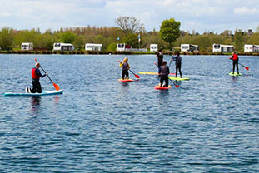

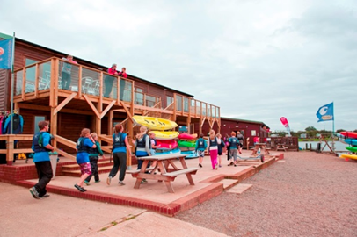
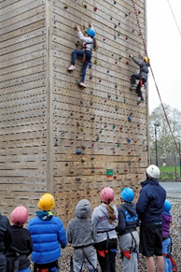
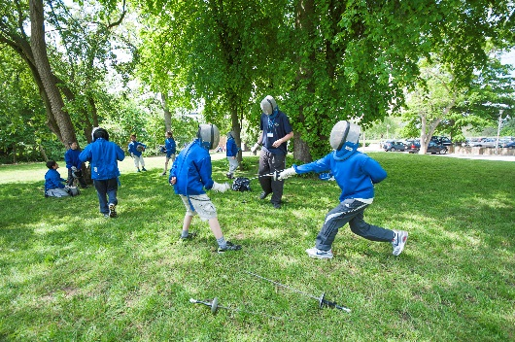
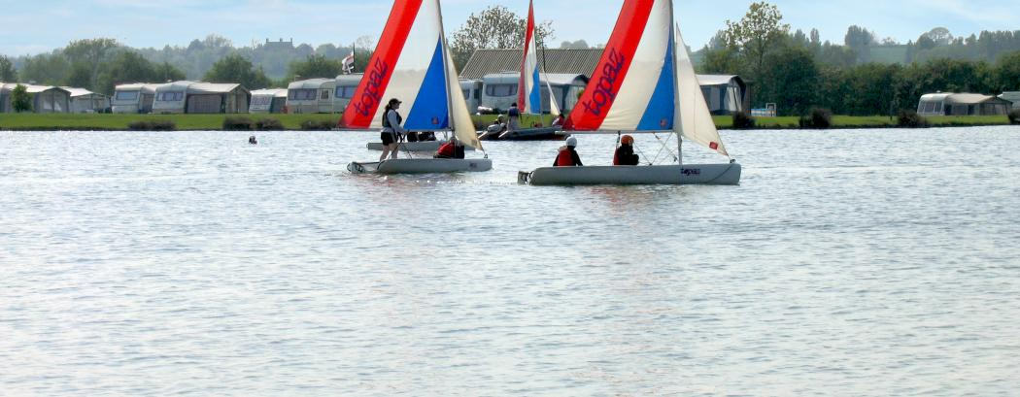
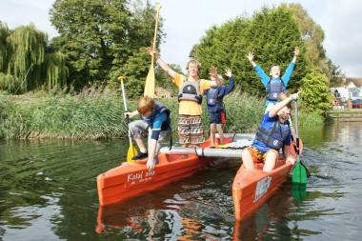
A sample day:
8.00am breakfast
9.00-10.30am 1st activity
10.30-10.45am break
10.45am-12.15pm 2nd activity
12.15pm lunch
1.45-3.15pm 3rd activity
3.15-3.30pm break
3.30-5.00pm 4th activity
5.30pm evening meal
6.30pm free time
7.00-8.30pm evening activity
8.30pm return to rooms / get ready for bed
Over the week we will do:
- 4 x 3 hour water sports
- 8 x 1.5 hour land-based
- 4 x 1.5-hour evening

Slide 8
To be confirmed – from:
Abseiling
Archery
Buggy Building
Canoeing
Circus Skills
Climbing
Dance Mania
Fencing
Initiative Exercises
Kayaking
Mini Olympics
Orienteering
Raft Building
Rocket Launch
Sailing
Sensory Trail
Sit on Top Kayak
Stand Up Paddle Boarding
Team Challenge
Wide Games
Windsurfing
 | Morning |  | Afternoon |  | Evening
Sessions | 1 | 2 | 3 | 4 | 5
Monday | Travel to Croft Farm |  | Intro Tour | Archery | Giant Cluedo
Tuesday | Kayaking |  | Orienteering | Sensory Trail | Egg Protector
Wednesday | Fencing | Climbing | Raft Building |  | Camp Fire
Thursday | Canoeing |  | Abseiling | Buggy Build | Disco
Friday | Sailing |  | Travel back to school
EXAMPLE

Slide 9
WHAT TO BRING
See kit list
Your child will have to carry everything from the coach to their accommodation - please do not bring too much!​
Pack with your child, so they know what they have got!​
Please, please label everything, including bags that bedding is put in a separate named bag for last day's change of clothes

Slide 10
KIT LIST
Clothes
Night wear
Underwear
10 Pairs of socks (including plenty of spares)
Trousers (It is important that the students do not wear jeans whilst doing the activities for safety and comfort reasons)
Shorts
T-Shirts
Long sleeved top for archery Jumper/sweatshirt/fleece
Waterproof jacket/anorak Waterproof trousers or trousers that can get muddy
Disco Clothes
Other
Towels
Swimwear
Trainers or other substantial footwear, plus extra to get wet/dirty
Toiletries Toothbrush Toothpaste Sponge/facecloth Soap / Shower gel Hair products i.e. shampoo/conditioner
Hair ties (for long hair)
Sun cream
Sunglasses
Book/magazine to read
Water bottle
Gloves/hat/cap
Camera (NOT a phone or tablet – even if SIM has been removed)
Small Torch
Sleeping bag/duvet and pillow (children only)

Slide 11
WHAT TO BRING
old clothes you don’t mind getting dirty​
old trainers that you don’t mind getting wet/dirty ​
spare pair of trainers / shoes to wear home​
'wet clothes' (including trainers, swimming costume, clothes to wear in the water)​

Slide 12
WHAT TO BRING
Packed lunch for first day (no other food please)​
Plastic bag to bring dirty and wet clothes home in!​
No aerosols​
No money needed
Optional
  Pocket-sized game / book / small toy / pack of cards (no electricals)
  Teddy
  Camera (not a mobile phone or tablet – even without SIM)

Slide 13
TIMINGS
Monday 13th July
Children to arrive at school – time to be confirmed - with their clothing & sleeping bags and pillows. Please pack light! We are leaving at approximately 10am (time tbc).
ALL CHILDREN MUST BRING A PACKED LUNCH to have when they arrive at Croft Farm.
Friday 17th July
We should arrive back by 3.15pm (pick up as normal).
If delayed, we will let the office know – we will notify you if it is going to be after 3.30pm.

Slide 14
MEDICATION - VERY IMPORTANT!
All medication must be brought to the school office by Monday 6th July with
signed consent form
in original packaging from pharmacy, with information leaflet, and
if prescribed, it must come in with prescription label on
We will be taking Calpol (no need to send it in).
You will get an email about this after half term.
Please do not bring it in on the morning of the trip.

Slide 15
QUESTIONS?

