Slide 1

Year 5 Meeting
Wednesday 2nd July 2025
4pm-4:30pm

Slide 2
Purpose
Outline of the year
Curriculum
Refer to Friday Flyer / School comms
Questions - end

Slide 3


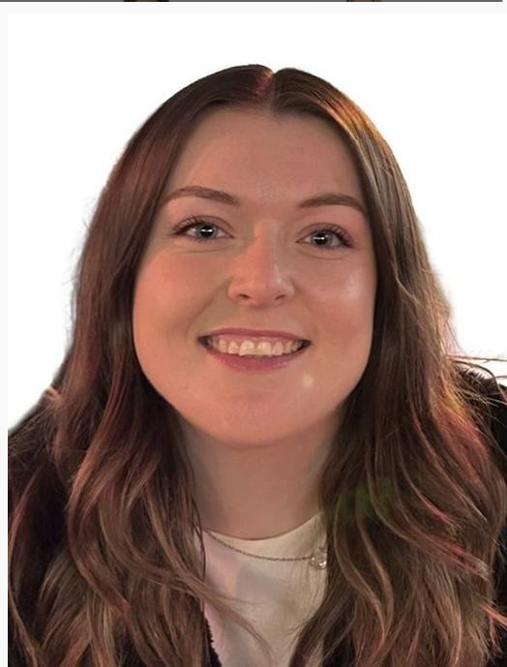
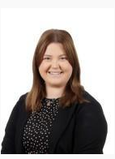
Year 5 Staff
Potters
Teacher:
Miss McGill
Weasleys
Teacher:
Miss Gould

Slide 4

Aims for Year 5
Help the children to gain more independence
Give the children more responsibilities
A fun and enjoyable year at the top end of the school
Prepare the children for the increased pace and challenge of Year 6 and beyond

Slide 5
Topics & Trips
Autumn
The Victorians
What is Brazil like? (Living Rainforest trip)
Spring
The Tudors (Hampton Court Trip)
North America
Summer
Early Islamic Civilisation
Climate change
Space (WonderDome visit)
Camp out - last half term

Slide 6

Maths – Power Maths
Place value to 100,000
Formal methods (+ - x ÷)
Fractions / Decimals / Percentages
Graphs / tables
Area and perimeter
Geometry – shape / position / symmetry
Reasoning, fluency, problem solving
Mastery - concrete, pictorial, abstract
Secure times tables knowledge – weekly retrieval practice

Slide 7
Maths – Helping at home
Support with homework - ask questions and giving opportunities for reasoning
My Maths has lesson alongside h/w set (either current unit or retrieval) -Checked and new one set on a Friday
Times Table – Regular Practice

Slide 8
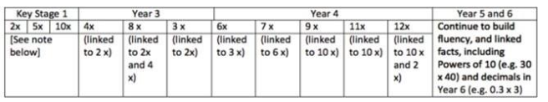
Maths – times table
What do children need to know?
National Curriculum states - by the end of Year 4, pupils should be capable of recalling all multiplication and division facts for multiplication tables up to 12x12
Fluency is essential for future success in mathematics
Year 4 - children sit an online ‘Multiplication Tables Check’ to determine whether they can recall their times tables fluently
What can I do at home to support my child?
Support them with their weekly “Terrific times tables” test
Help them practise the sheet they bring home
This can be done anywhere - walking / driving to school, in the park / garden / shops
Encourage them to practise using Times Tables Rock Stars (TTRS) weekly
Progression

Slide 9
Maths – times table
Key Stage 1 Terrific Times Tables:
Number bonds to 10 ​
Number bonds to 20
Levels 1-5: 2 times tables (terms ‘lots of’ and ‘groups of’)​
Levels 6-10: 5 times tables (terms ‘lots of’ and ‘groups of’)​
Levels 11-15: 10 times tables (terms ‘lots of’ and ‘groups of’)​
Levels 16-20: 2 times tables (x and ÷ symbols)
Levels 21-25: 5 times tables (x and ÷ symbols) ​
Levels 26-30: 10 times tables (x and ÷ symbols) ​
Bronze Levels 1-8: mixed 2s, 5s and 10s (x and ÷ symbols)
Key Stage 2 Terrific Times Tables:
Levels 1-7: 4 times tables (x and ÷ facts)​
Levels 8 -14: 8 times tables (x and ÷ facts)​
Levels 15 - 23: 3 times tables (x and ÷ facts)​
Levels 24 - 30: 6 times tables (x and ÷ facts)​
Levels 31 - 39: 7 times tables (x and ÷ facts)​
Levels 40 - 48: 9 times tables (x and ÷ facts)​
Levels 49 - 55: 11 times tables (x and ÷ facts)​
Levels 56 - 65: 12 times tables (x and ÷ facts)​
Bronze levels 1-7: squaring and square roots ​
Silver levels 1-7: multiplying decimals
KS1 and KS2 Terrific Times Tables Key Information:
Tested once a week, 2 minutes given
Pass = KS1 allowed one mistake + KS2 allowed two mistakes ​
Next week – repeat, or move to next level if pass
Stickers – awarded Y1-3, Certificates – awarded in Y4-6, Badges – awarded when ‘Bronze’ levels completed.

Slide 10
English writing – across the curriculum
write for different purposes and audiences
describe the settings, characters and atmosphere
integrate dialogue
Vocabulary / grammar appropriate for the audience (descriptive detail, evoke a setting, vivid, create mood and atmosphere)
build cohesion/flow in writing
use tenses consistently / correctly
use the range of punctuation correctly (e.g. speech, commas, dash, colon, etc.)
spell (all) Year 3 / 4 list and (some) Year 5/6 list
handwriting is joined and clear

Slide 11

SPAG - spelling
Spelling rules (e.g. –able/-ible)
Silent letters (e.g. knight, solemn)
Homophones (e.g. affect/effect, who’s/whose, practice/practise)
Suffixes and prefixes
Year 5/6 Statutory Words (listed on Padlet weekly)

Slide 12
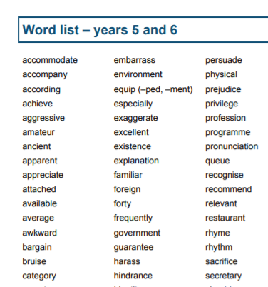

Slide 13

Grammar
Possessive apostrophes
Hyphens, brackets and dashes for parenthesis
Relative clauses and pronouns
Adverbials
Modal Verbs to indicate possibility
Commas to clarify meaning
Figurative language
Inner thought

Slide 14

Handwriting
What does it look like in school?
Daily handwriting lessons following Morrells Handwriting scheme in KS2 and Little Wandle in EY and KS1
Handwriting warm-ups to strengthen finger and wrist muscles
Sitting in the correct handwriting position (4 chair legs on the floor, 2 feet flat on the floor and 2 hands on the table)
Correct pencil/pen grip
Heavy focus on letter formation before joining
Additional interventions if needed
What can I do at home to support my child?
Take your child to the park where they can strengthen their finger muscles whilst climbing and gripping.
Serve drinks in cups with a handle rather than a bottle which requires a fist grip
Encourage them to carry their own book bag (again, encouraging the strengthening of finger muscles)
Chores!
Use metal cutlery
Do arts/crafts and cooking together
If you have any concerns over your child's handwriting, please do not hesitate to come and speak to us.

Slide 15

Reading
  So important!
  At least 3 times a week - recorded in journal. The children can do this.
  Children’s reading journal to be handed in weekly on Monday
  Home reading for pleasure
    summarise thoughts, predict, discuss vocabulary and author's choice, questions
  A range of texts
  In reading records comments could include:
  How writer creates mood / atmosphere
  Inference – deductions about motives
  Justify their opinion
  Not just "It was good."

Slide 16
The Word Gap
At five years old:
Never read to – 4,622 words
1-2 times a week – 63, 570 words
3-5 times a week – 169, 520
Daily – 296, 000 words
Five books a day – 1, 483, 300 words
Science Daily (2019)
https://www.sciencedaily.com/releases/2019/04/190404074947.htm
Notes:
Young children whose parents read them five books a day enter kindergarten having heard about 1.4 million more words than kids who were never read to, a new study found. This 'million word gap' could be one key in explaining differences in vocabulary and reading development.
The vocabulary word gap in this study is different from the conversational word gap and may have different implications for children, she said.
"This isn't about everyday communication. The words kids hear in books are going to be much more complex, difficult words than they hear just talking to their parents and others in the home," she said.
For instance, a children's book may be about penguins in Antarctica -- introducing words and concepts that are unlikely to come up in everyday conversation.

Slide 17
Guided Reading
  Daily reading of quality texts:
  Master Readers approach
  Whole class shared reading
  'Book Club' - discuss a shared text
  Modelled comprehension (retrieve, inference, vocabulary, prediction and author choice)
  Written comprehension

Slide 18

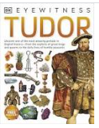






Slide 19




Slide 20


Slide 21

Oracy
What is oracy?
"Oracy is articulating ideas, developing understanding and engaging with others through speaking, listening and communication."- Voice 21
Empowers ALL children to share and articulate their ideas in a safe environment
At ACS, we are encouraging the children to develop their speaking and listening skills through the Voice 21 programme where we have implemented:
A listening ladder in every classroom
The Talk Tactics to be used during discussions (build, challenge respectfully, probe, clarify)
The power of sentence stems
Further elements of Oracy will be added across the next academic year.
We strongly encourage you to urge your children to showcase the Talk Tactics during discussions at home. You can promote a discussion in many ways, including:
A would you rather- 'Would you rather be a spoon or a fork?'
A big philosophical question- 'If you ruled the world, what would you change?'
For more information, visit https://voice21.org/

Slide 22

Science
Living things and habitats
Animals / humans
Properties of materials
Earth and space
Forces
Working scientifically
planning enquiries / taking measurements / using scientific equipment / presenting findings

Slide 23
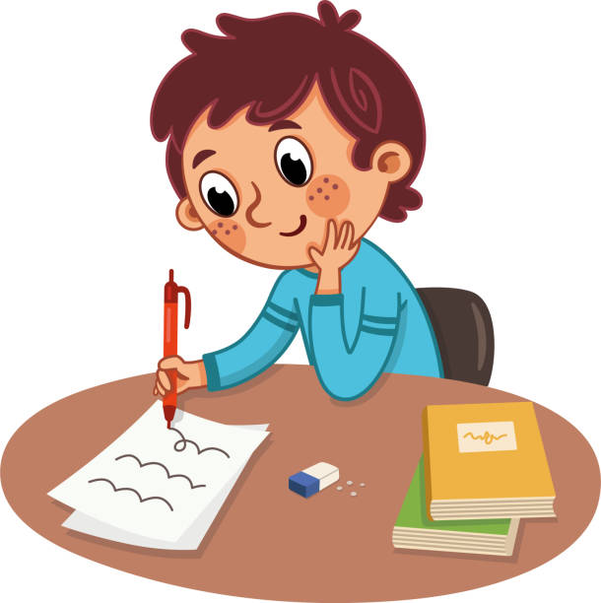
Homework
Weekly My Maths
Daily reading
Spelling
Times Tables

Slide 24

Useful equipment
Each child will have an allocated locker, which will need to fit everything inside.
One pencil case (fits in a drawer):
Essential:
pencil
blue handwriting pen
purple editing pen
whiteboard pen
Ruler
Protractor
glue stick
Optional:
Colouring pencils/pens
Scissors
Sharpener

Slide 25
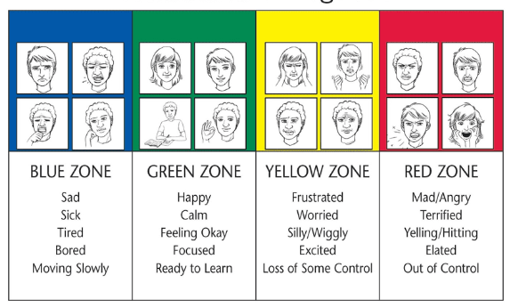
Zones of Regulation

Slide 26
Assessments
Termly – maths, reading, grammar, spelling
Prepare children for end of Y6 assessments
Only part of the picture

Slide 27
Communication
Friday Flyer
Termly curriculum newsletter
Snapshots
e-mail to Office
Arranged call/meeting
Parents’ evening / reports – share progress/test scores

Slide 28

Please remember not to have your phone out
when picking up your child on the school site.
Why?
Research clearly states that smartphones are negatively impacting children.
In school, we have seen a rise in children bringing their phone-based behaviour patterns into school which is leading to classroom conflicts and distraction from learning.
Sleep issues, rising levels of anxiety.....

Slide 29


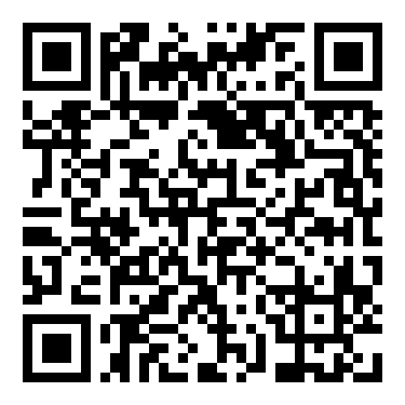
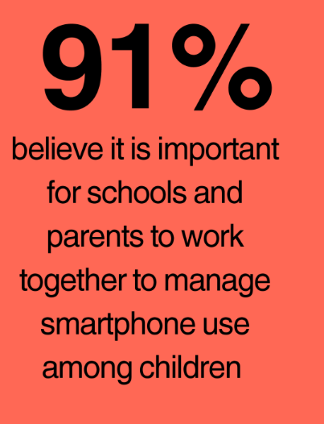
For more information or support on the topic of
smartphones, visit:
smartphonefreechildhood.org
The website has some excellent resources which are well worth a look.
Have you heard about the Parent Pact?
It’s a growing national movement of families choosing to delay giving children smartphones until at least age 14, and social media until 16 – and doing it together, so no one feels like the only one holding out.
It’s already been signed by families at 45% of schools in the UK, and you can see live data for which schools have the most Pacts signed in our area.
As a school community, we’re lending our support to this movement – not because we believe there’s one right way to do things, but because we think this is an important conversation for all of us.
A local group of parents from Aston Clinton, supporting the movement.
Survey results, 2025 (ACS)

Slide 30
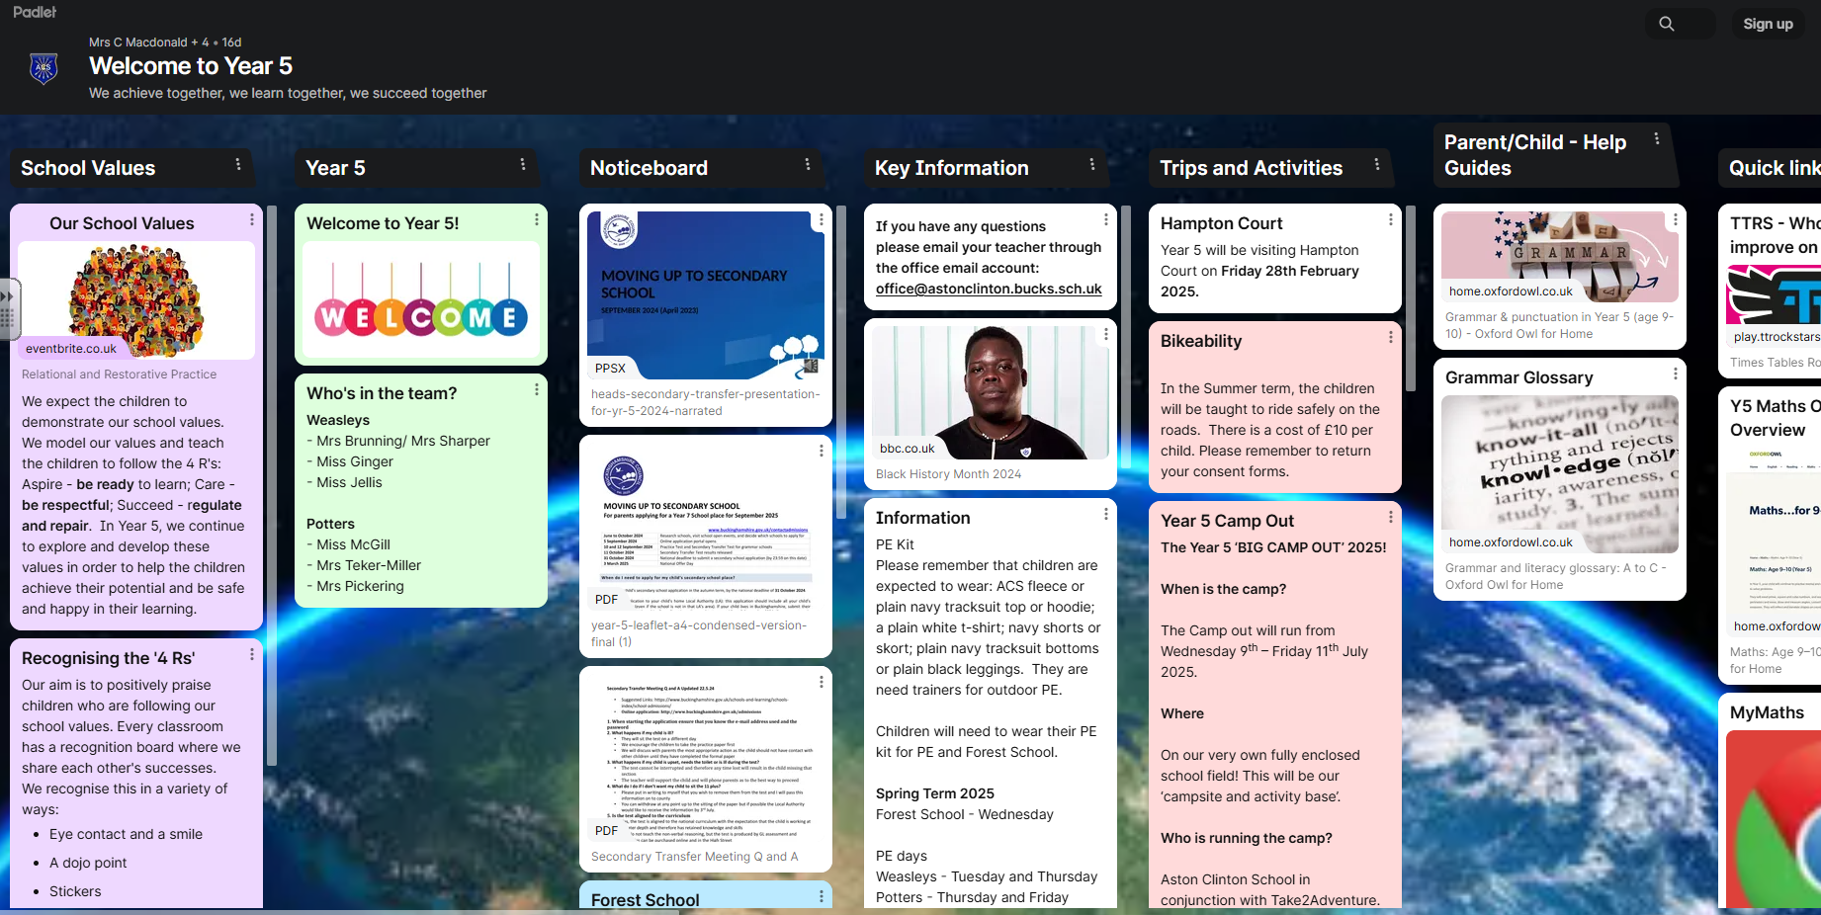
Padlet
On the school website is our Padlet
This is a one stop reference for all things Year 5!
https://padlet.com/astonclintonschool/welcome-to-year-5-9l4tk2jxzdsug20i

Slide 31

PE timetable (days tbc)
Weekly - PE
Weekly - Forest School
Come into school wearing the correct uniform:
Black or Navy Shorts
White T-shirt
Black Trainers
Tracksuit or jogging bottoms and sweatshirt (blue or black)
School jumper/ cardigan - no hoodies.
Long sleeve for Forest School
All named and no logos please!
Wellies for Forest School in the Winter

Slide 32
Summer Learning
  Postcards
  Have fun!

Slide 33

Questions?

